Slide 1



Crime Data Analysis
PROJECT GUIDE
YOGA M
BY
SANDEEP N
22ADR091
VASANTHASRI T
22ADR116
SUBHADEVI K
22ADL133

Slide 2
INTRODUCTION
Purpose: To enhance the analysis of crime data, improve data interpretation, and ensure better decision-making by adjusting the accuracy and relevance of crime patterns.
Scope: Develop algorithms and models to automatically analyze and predict crime patterns across different environments, such as urban areas or specific neighborhoods. Focus on achieving accurate trend detection while preserving data integrity and ensuring a balanced approach to crime categorization and geographic
Expected Outcomes: Improve the accuracy of crime pattern recognition, enhance the effectiveness of law enforcement and community safety strategies, and support better decision-making in fields like criminal justice, urban security, and policy development.

Slide 3


OBJECTIVE
To develop a smart system capable of accurately analyzing crime data and identifying patterns and trends.
To enhance the efficiency of crime data analysis by utilizing advanced data processing and machine learning techniques.
To automate the detection and prediction of crime hotspots, reducing manual analysis efforts and improving response times.
To improve the reliability and accuracy of crime forecasting across various regions and crime categories, and policymakers.

Slide 4
DATASET DESCRIPTION
The dataset sourced from Kaggle contains 752,911 rows with comprehensive crime data, making it suitable for detailed analysis of trends and patterns.
DR_NO, a unique identifier, ensures accurate tracking of individual crime cases and prevents duplication in the database.
TIME OCC records the exact crime time in a 24-hour format (e.g., 1345 for 1:45 PM), helping authorities analyze peak crime hours and improve patrol strategies.
AREA and AREA NAME provide both numeric codes and names of regions, enabling analysts to compare and study localized crime trends across jurisdictions or neighborhoods.
Rpt Dist No acts as a sub-regional identifier, helping law enforcement allocate resources effectively in smaller districts prone to specific crimes.

Slide 5
DATASET DESCRIPTION
Victim Information, including Vict Age, Vict Sex, and Vict Descent, identifies vulnerable demographics, aiding in targeted prevention measures for specific groups.
Crime Details such as Crm Cd Desc (crime type) and Mocodes offering insights into criminal behavior and prevention strategies.
Premis Cd and Premis Desc categorize and detail crime locations enabling authorities to focus on safeguarding high-risk premises.
Geospatial Data like LAT and LON, along with LOCATION, allows precise mapping of incidents, supporting hotspot analysis and aiding in proactive policing.
Case Status Fields, such as Status and Status Desc, provide insights helping evaluate law enforcement efficiency and case management.

Slide 6
PREPROCESSING
Data Cleaning: Handled missing values, duplicates, and irrelevant entries for a cleaner dataset.
Data Transformation: Converted categorical data into numerical values using encoding techniques.
Feature Scaling: Applied normalization/standardization to maintain consistency in data ranges.
Data Integration: Merged multiple data sources to create a comprehensive dataset.
Feature Selection: Identified and retained relevant features to improve analysis accuracy

Slide 7
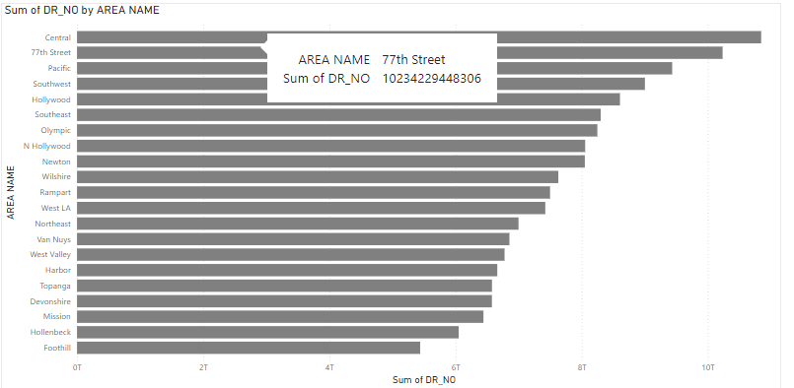
QUESTIONS
What is the total number of crimes reported in each area?
The Central area reports the highest crime rate, possibly due to its population density and economic challenges. This indicates a need for focused law enforcement and community engagement in such high-risk areas.

Slide 8
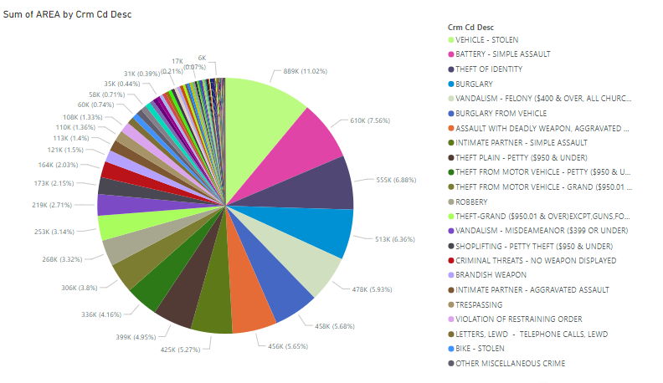
2. What is the distribution of crime types across different areas?
Vehicle thefts dominate specific areas, suggesting weaknesses in security measures and potential crime magnet zones. Increasing awareness and security initiatives could mitigate such incidents.

Slide 9
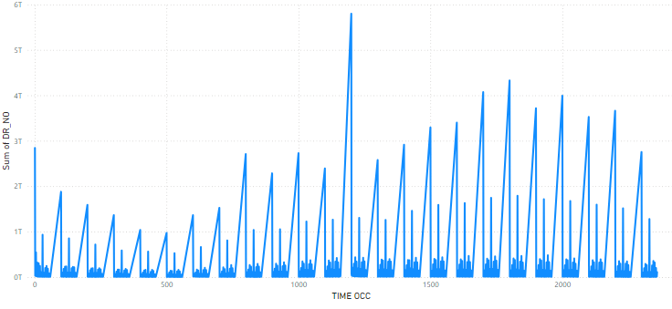
3. How does crime frequency vary by time of day?
Crimes peak during late evenings and early mornings, when visibility and public presence are low. Targeted patrols during these hours could help deter criminal activity.

Slide 10
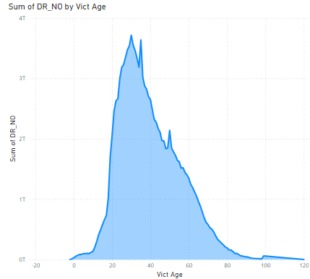
4. How do crime rates differ across various age groups of victims?
Victims aged 30 are most affected, highlighting a need for targeted safety measures for younger adults.

Slide 11
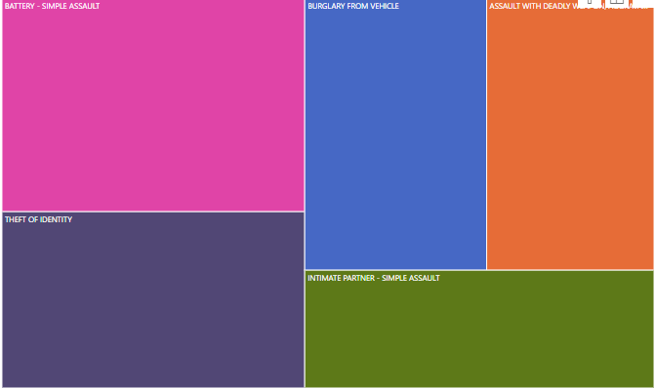
5. What are the top 5 most common crime categories?
Battery and assault dominate, calling for enhanced public safety and conflict resolution efforts.

Slide 12
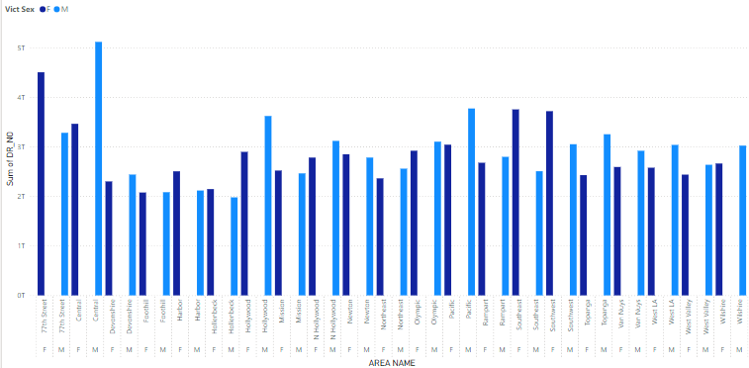
6. Find gender wise crime rate in specific area?
Female crime rates are highest in Central, while male crime rates dominate the 77th Street area.

Slide 13
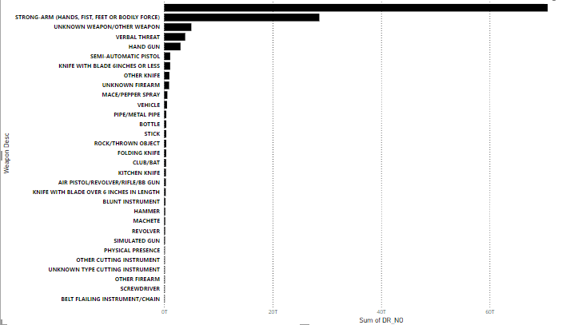
7. What types of weapon are used for the crimes?
Strong Arm" assaults are most common, showing a prevalence of close-contact crimes over lethal weapons.

Slide 14
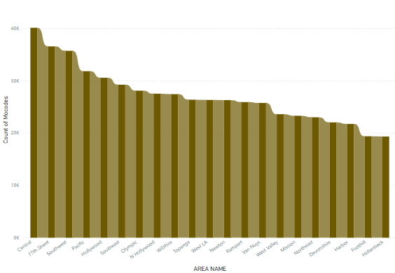
8. Find the highest mocodes with respect to the area name ?
Central leads in crimes with high Mocodes, indicating a need for focused law enforcement and interventions.

Slide 15
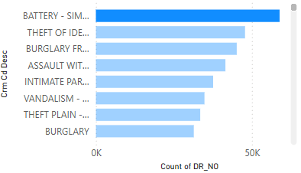
9. What is the distribution of crimes by type?
Central has the most diverse crime types, highlighting the need for targeted policing strategies.

Slide 16
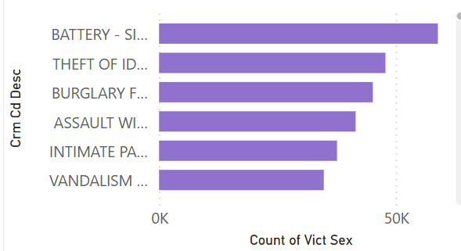
10. How does victim gender vary across different crime types?
Certain crimes affect men or women disproportionately, guiding gender-focused prevention programs.

Slide 17
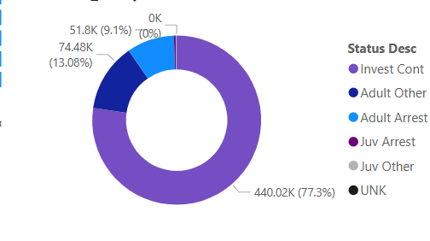
11. What is the status distribution of reported crimes?
Analyzing case status (e.g., resolved, open) helps assess law enforcement efficiency and resource needs.

Slide 18
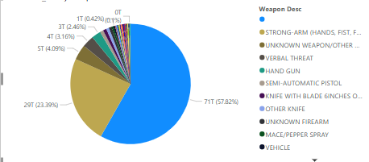
12. What types of weapons are most commonly associated with crimes?
Close-contact weapons like "Strong Arm" are most common, indicating personal assault trends.

Slide 19
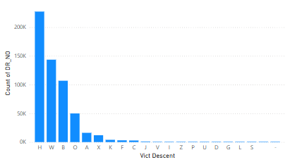
13. How does crime frequency vary by victim’s descent?
Crime frequency varies across demographics, revealing groups needing targeted safety initiatives.

Slide 20
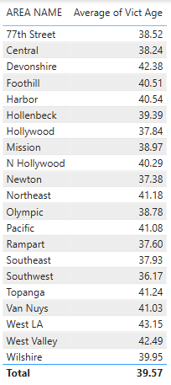
14. Which areas have the highest average victim age?
Crime frequency varies across demographics, revealing groups needing targeted safety initiatives.

Slide 21
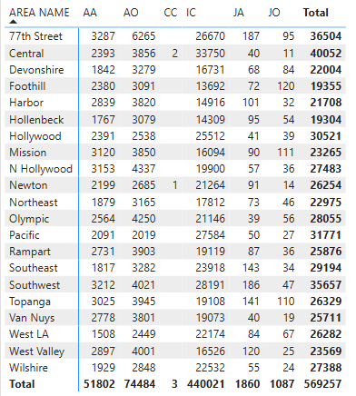
15. What is the most common crime status in each area?
Unresolved cases highlight areas needing better resource allocation for crime resolution.

Slide 22
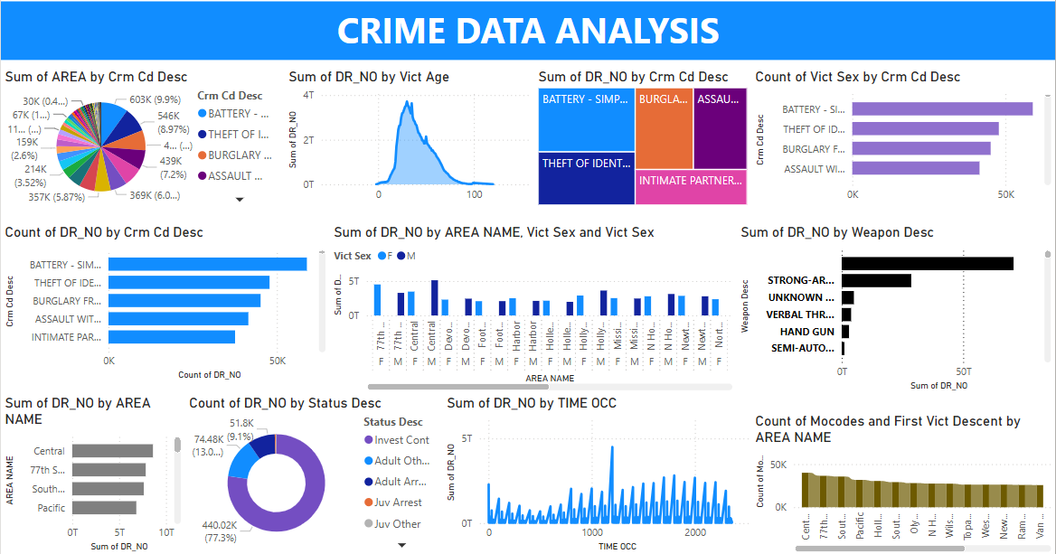
DASHBOARD

Slide 23
REFERENCE
McClendon, Lawrence, and Natarajan Meghanathan. "Using machine learning algorithms to analyze crime data." Machine Learning and Applications: An International Journal (MLAIJ) 2.1 (2015): 1-12.
Shermila, A. Mary, Amrith Basil Bellarmine, and Nirmala Santiago. "Crime data analysis and prediction of perpetrator identity using machine learning approach." 2018 2nd international conference on trends in electronics and informatics (ICOEI). IEEE, 2018.
Safat, Wajiha, Sohail Asghar, and Saira Andleeb Gillani. "Empirical analysis for crime prediction and forecasting using machine learning and deep learning techniques." IEEE access 9 (2021): 70080-70094.
Kim, Suhong, et al. "Crime analysis through machine learning." 2018 IEEE 9th Annual Information Technology, Electronics and Mobile Communication Conference (IEMCON). IEEE, 2018.

Slide 24
THANK YOU

